Slide 1
Problem Solving with Loops

Slide 2
The following "non-computer" algorithms involve repetition:
Compute the course grade for every student in a class.
Microwave the food until the timer reaches 0, the cancel button is hit, or the door is opened.
While the ATM is running, process another customer.
While there are more burger/fries/soda orders, sum each item. Apply tax. Display Total.

Slide 3
Introduction
The loop logic structure is the repeating structure. It allows code to be repeated until a condition in the data is met.
Loops also allow the programmer to return to an earlier portion of the code.
A looping structure makes a decision every time the loop is repeated.
As long as the decision is true, the statements in the loop repeat. A loop stops when the loop test is false.

Slide 4

Why Iterate
To take advantage of the computer's speed in doing the same task faster than if done by hand.
Because some algorithms require the repetition of the same steps thousands of times.
To avoid writing long programs that are not general enough to be useful.
  Consider a program to find the average of a set of numbers:

Slide 5
Average 100 Numbers
int sum = 0;
cout << "Enter number: "; // <-Repeat these three
cin >> number; // <-statements for each
sum = sum + number; // <- number in the set
cout << "Enter number: "; // Cut and Paste??
cin >> number;
sum = sum + number;
// ...[ 288 statements deleted ]...
cout << "Enter number: ";
cin >> number;
sum = sum + number;
...
average = sum / 100;
With a statement that has the ability to repeat a group of statements, we only need about three statements (not 300) :

Slide 6
While there is another number, do the following
{
cout << "Enter number: ";
cin >> number;
sum = sum + number;
}
average = sum / 100;
If we know how many numbers there are in advance, we can use a counter-controlled loop, which executes for a pre-specified (known in advance) number of iterations.

Slide 7
Problem: Conversion table degrees → radians
Degrees to Radians
0 0.000000
10 0.174533
20 0.349066
30 0.523599
…
340 5.934120
350 6.108653
360 6.283186
radians = degrees * PI / 180;

Slide 8
Sequential Solution
#include <iostream.h>
#define PI 3.141593
int main(void)
{
int degrees=0;
double radians;
cout<<"Degrees to Radians \n";
degrees = 0;
radians = degrees*PI/180;
cout<<degrees<<“\t”<<radians;
degrees = 10;
radians = degrees*PI/180;
cout<<degrees<<“\t”<<radians;
degrees = 20;
radians = degrees*PI/180;
cout<<degrees<<“\t”<<radians;
…
degrees = 360;
radians = degrees*PI/180;
cout<<degrees<<“\t”<<radians;
}
degrees = ???
radians = degrees*PI/180;
cout<<degrees<<“\t”<<radians;
Not a good solution

Slide 9
Loop Solution
#include <iostream.h>
#define PI 3.141593
int main(void)
{
int degrees=0;
double radians;
cout<<“Degrees to Radians”;
while (degrees <= 360) {
radians = degrees*PI/180;
cout<<degrees<<“\t”<<radians;
degrees += 10;
}
}
degrees = ???
radians = degrees*PI/180;
cout<<degrees<<“\t”<<radians;
degrees+=10
means
degrees= degrees+10

Slide 10

Loops in a Solution
The designer of the solution must determine when a loop is necessary.
Often this is done by identifying a subtask that needs to be repeated on a different set(s) of data in the process of determining an answer.
  Find and report all the students which took “A” in this class.
  Determine the average for each student in the class and then report the class average.

Slide 11
The Three Kinds of Loops
1. The “while” loop
  Repeats while a condition is true and ends when the condition becomes false
2. The “repeat- until” loop
  Repeats while a condition is false and ends when a condition becomes true.
In CS these loops are considered indefinite loops because the programmer may not always know when the loop will be stopped in any one running of the program. (how many students in the class?)

Slide 12
The Types of Loops cont.
3. The “Counting” loop
  An integer variable is set (generally to 0) and then for every repetition of the loop the variable is incremented until is reaches a set value, at which time the loop is stopped.
Each loop has its uses in the solution, and each has different characteristics, but all are still loops and may be infinite if not composed correctly.

Slide 13
Loops In C++
while( T/F) // The while loop//repeats on True
{
  //Statements to be repeated
}
do //The do - while loop
{
  Statements to be repeated
} while( T/F); //repeats on True

Slide 14
Loops in C++ cont.
for( start; test; action) //the for loop
{
  statements to be repeated
}
This is C++’s counting loop and repeats as long as the test is true.
The sequence is: start – test(T) - iteration stmts - action - test(T) - iteration stmts - action - test -…………..[Note start only happens once]

Slide 15
while statement
while(expression)
statement;
while(expression) {
statement;
statement;
…
}

Slide 16
The following loop template can be used to perform n iterations
n = Number of intended iterations
counter = 1;
while ( counter <= n )
{
cout << "Enter number: "; //Repeat these three
cin >> number; //statements for each
sum = sum + number; //number in the set
counter = counter + 1; //track # repetitions
}
Counter keeps track of the number of repetitions. As soon as counter exceeds n, the loop terminates. Let's look at the general form.

Slide 17
When a while loop executes, the loop-test is evaluated. If true, the iterative part is executed and the loop-test is reevaluated. This process continues until the loop test is false. For example, counter <= n must eventually become false for the following loop to terminate:

Slide 18
#include <iostream.h>
int main()
{
int counter = 1;
int n = 4;
while(counter <= n)
{
cout << counter << endl;
counter = counter + 1;
}
return 0;
}

Slide 19
The following things should be considered when writing a loop:
1. Write the statements to be repeated.
cout << "Enter test: "; // <-Repeat these
cin >> test; // <- three
sum = sum + test; // <-statements
2. Determine the loop-test. With counter-controlled loops, follow this template:
while(counter <= n)
3. Bring the loop one step closer to termination.
counter = counter + 1;
4. Initialize objects before the loop-test if necessary.
float sum = 0; int counter = 1; cin >> n;

Slide 20
All Loops Have:
1. A primer or initial value for the first test
2. A test in the loop that must become false in order to exit the loop.
3. A statement(s) that brings the loop closer to termination or the potential for setting the decision variable to false in order to terminate the loop.

Slide 21
Infinite loops
An infinite loop is one that never terminates.
They are usually not desirable––an example:
int counter = 1;
int j = 0;
int n = 3;
while(counter <= n)
{
j = j + 1;
cout << counter << endl;
}
cout << "Do we ever get here?" << endl;
There is no step that brings us closer to loop termination––it's an infinite loop.

Slide 22
Another potential infinite loop
int Count = 1;
while(Count > 0)
{
  ………..
  cout << “Enter your answer” << endl;
  cin >> Ans;
  Count++;
  ………
}

Slide 23
Programming and Infinite Loops
If you are working in an integrated environment on a PC, remember to save your files before running a program with a loop. You might loose work if you don't save the file.
How do you terminate a program containing an infinite loop? X, Cntrl-C,
Cntrl-Alt-Del and terminate task.

Slide 24
Another Example
cout << "Enter test scores or -1 to quit" << endl;
cin >> TestScore; // Priming variable for loop test
while(TestScore != -1)
{
Accumulator = Accumulator + TestScore;//Process TestScore
cin >> TestScore; // Input test or -1
} //for the next iteration

Slide 25
Another Example
#include <iostream.h>
#define PI 3.141593
int main(void)
{
int degrees=0;
double radians;
cout<<"Degrees to Radians”;
while (degrees <= 360)
{
radians = degrees*PI/180;
cout<<degrees<<“\t”<<radians;
degrees += 10;
}
return 0;
}

Slide 26
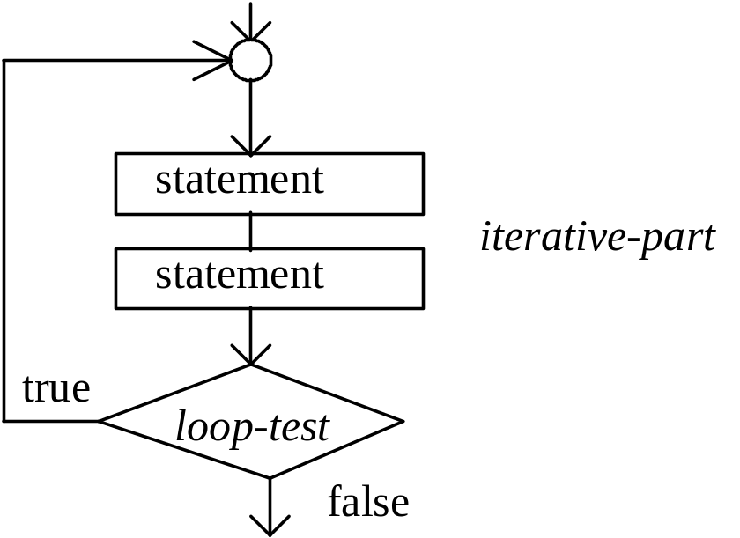
The C++ do.. while( ) statement
Implements the repeat-until
The do while statement is similar to the while loop, but the do while() loop has the test at the end. General form:
Notice the iterative part executes BEFORE the loop-test):

Slide 27
do while
do
statement;
while(expression);
do {
statement1;
statement2;
...
} while(expression);
note - the expression is tested after the statement(s) are executed, so statements are executed at least once.

Slide 28
The do while loop is a good choice for obtaining interactive input from menu selections.
Consider a function that will not stop executing until the user enters an N, O, or S:
char Option = ‘ ‘;
do
{
cout << "Enter N)ew, O)pen, S)ave: ";
cin >> Option;
} while (Option != 'N' && Option != 'O' &&
Option != 'S');

Slide 29
Example
#include <iostream.h>
#define PI 3.141593
int main(void)
{
int degrees=0;
double radians;
cout<<"Degrees to Radians”;
do
{
radians = degrees*PI/180;
cout<<radians;
degrees += 10;
} while (degrees <= 360);
return 0;
}

Slide 30
The for() Loop (C++’s Counter Loop)
The for() loop statement contains all the parts of the loop on one line. The for loop forces us to write, as part of the for() loop, an initializing statement, the loop-test, and a statement that is automatically repeated for each iteration.
For example, we can write a counter-controlled loop like this
for(int Counter = 1; Counter <= 5; Counter++)
{
cout << Counter << " ";
}
Output: ________________________________________?

Slide 31
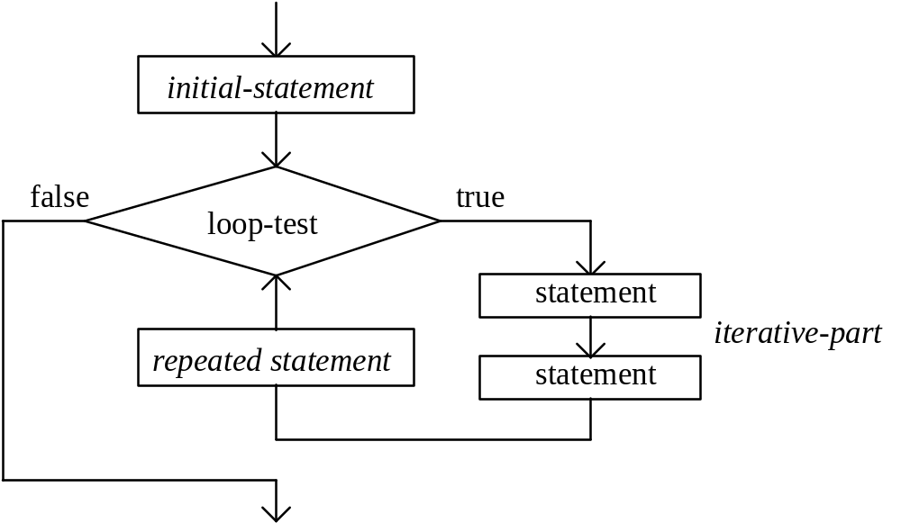
The general form of a for loop is given as:
for ( initial statement (start) ; loop-test ; repeated statement (action) )
{
iterative-part;
}

Slide 32
for statement
for(initialization ; test ; increment or decrement )
statement;
for(initialization ; test ; increment or decrement )
{
statement;
statement;
…
}

Slide 33
When a for loop is encountered, the initial-statement is executed. The loop-test is executed. If loop-test is false, the for loop is terminated. If loop-test is true, the iterative-part is executed and the repeated-statement is executed. The process repeats by evaluating loop-test, and so on ...

Slide 34
Example
#include <iostream.h>
#define PI 3.141593
int main(void)
{
int degrees;
double radians;
cout<<“Degrees to Radians “;
for (degrees=0; degrees<=360; degrees+=10)
{
radians = degrees*PI/180;
cout<<radians;
}
return 0;
}

Slide 35
//Example of a for loop that produces an average
//of user-supplied values:
int n = 0, Value = 0, Sum, Average = 0;
  cout << "Enter n: "; // get a value for the number of iterations
  cin >> n;
  Sum = 0; // Initialize sum to 0 to ensure the correct average
  // Iterate the same three statements n times
  for (int Counter = 0; Counter < n; Counter = Counter + 1)
  {
  cout << "Enter number: ";
  cin >> Value;
  Sum = Sum + Value; //accumulate
  }
  Average = Sum / n; // Compute and display the average
  cout << "Average: " << Average;

Slide 36
Loop Selection and Design
The following outline is offered to help you choose and design loops in a variety of situations:
  1. Write the statements to be repeated.
  2. Determine which type of loop to use.
  3. Determine the loop-test.
  4. Bring the loop one step closer to termination.
  5. Initialize variables as necessary.

Slide 37
Write the Statements to be Repeated
This is why the loop is being written in the first place. This may be done after the other parts.
  These are the iterative statements or the parts of the code that should be run over and over if the loop condition is true.
  These statements may be any legal C++ statement

Slide 38
Determine Which Type of Loop to Use
The number of repetitions is known in advance or read as input, use a counter-controlled for loop
If you must stop the loop when some event occurs during execution of the loop, use an event-controlled while loop
If the loop must always execute once (to validate input), use a do-while loop

Slide 39
Determine the Loop-Test
Try writing the conditions that must be true for the loop to terminate.
The logical negation ( ! ) can be used directly in the loop-test of any loop:
while(!Success) // !Success //is opposite of Success
  While not successful repeat!

Slide 40
Bring the Loop one Step Closer to Termination
To avoid an infinite loop, there should be at least one action in the loop body that brings it closer to termination.
Examples:
  1. Increment the counter by +1.
  2. Extract data from the user e.g., Yes or No.
  3. Use a decision in the loop to set the loop condition/decision to false.

Slide 41
Initialize Variables as Necessary.
Check to see if any variables used in either the body of the loop or the loop-test need to be initialized.
Consider this loop:
int j, n;
float x, sum;
while(j <= n)
{
cout << "Enter a number: ";
cin >> x;
sum = sum + j;
j++;
} //Which variables need to be initialized before this while( ) loop is //encountered??

Slide 42
Nested Loops Example
Loops may be nested just as decisions are able to be nested.
  for(int I = 0; I < 4; I++)
  {
    cout << “One more time” << endl;
    do
    {
      cout << “Enter a Number or -1 to go on: ” ;
      cin >> Num;
    }while(Num != -1);
  }

Slide 43
Some examples
//This is a test for a while
#include<iostream.h>
void main()
{
//open main
int counter=1;
float total;
float score;
while (counter <5)
{ //open while
cout<<"Enter score: ";
cin>>score;
total=total+score;
counter=counter+1;
} //end while
cout<<"Your total is: "<<total<<endl;
}//close main

Slide 44
// Filename: WHIL1.CPP
// Input routine to ensure user types a correct response.
// This routine can be part of a larger program.
#include <iostream.h>
void main()
{
char ans;
cout << "Do you want to continue (Y/N)? ";
cin >> ans; // Get user's answer
while ((ans != 'Y') && (ans != 'N'))
{
cout << "\nYou must type a Y or an N\n"; // Warn
// and ask
cout << "Do you want to continue (Y/N)? "; // again.
cin >> ans;
} // Body of while loop ends here.
}

Slide 45
// Filename: DoWhile.CPP
// A totaling program using a do-while loop.
#include <iostream.h>
void main()
{
int total = 0; // Initialize total
int num = 5;
do
{
total += num; // Add num to total
num++; // Increment counter
}while (num <= 10);
cout << "The total is " << total << "\n";;
}

Slide 46
// Filename: FOR1.CPP
// Introduces the for loop.
#include <iostream.h>
void main()
{
int ctr;
for (ctr=1; ctr<=10; ctr++) // Start ctr at one.
// Increment through loop.
{
cout << ctr << "\n";
} // Body of for loop.
}

Slide 47
// Filename: FOR2.CPP
// Demonstrates totaling using a for loop.
#include <iostream.h>
void main()
{
int total, ctr;
total = 0; // Holds a total of 100 to 200.
for (ctr=5; ctr<=10; ctr++) // ctr is 5, 6, 7, 8, 9, 10
{
total += ctr; // Add value of ctr to each iteration.
}
cout << "The total is " << total << "\n";
}

Slide 48
// Filename: WhileFor.CPP
// Displays an error message for a few seconds.
#include <iostream.h>
void main()
{
int outer, inner, age;
cout << "What is your age? ";
cin >> age;
while (age <= 0)
{
cout << "*** Your age cannot be that small! ***";
// Timing loop here
for (outer=1; outer<=30000; outer++)
{
for (inner=1; inner<=500; inner++);
}
// Erase the message
cout << "\r \n\n";
cout << "What is your age? ";
cin >> age; // Ask again
}
cout << "\n\nThanks\n";
}

